Slide 1


HealthQ
Optimizing Doctor Availability and Appointment Allocation in Hospitals through Digital Technology and AI Integration
Team Name : Maniacs
Team Members
Chakrika Gurrala
Suvarna Kancharapu
Likitha Majji
Git Hub:https://github.com/Suvarna112/HealthQ.git

Slide 2


Problem Statement
Problem Statement: Title Optimizing Doctor Availability and Appointment Allocation in Hospitals through Digital Technology and AI Integration.
Description: Optimizing Doctor Availability and Appointment Allocation in hospitals through Digital Technology and AI Integration aims to address inefficiencies in healthcare systems, particularly the long waiting times and mismatched doctor-patient schedules. In many healthcare facilities, patient appointments are often poorly managed, leading to overcrowding, underutilized resources, and frustrated patients. AI and digital tools can help streamline these processes by intelligently matching patient needs with doctor availability. Department Department of Medical Health & Family Welfare Sector Health

Slide 3

WHY ?
why do people neglect meeting doctors
Patients waiting for long hours for consultations
Old people always cannot come to the hospital due to their health conditions
Overcrowded hospitals due to poor time management, increasing infection risks
Emergency cases stuggling to get immediate attention due to rigid booking systems

Slide 4
HOW?
then how are we going to solve this problem
To address the inefficiencies in doctor availability and appointment allocation, we propose an AI-powered digital scheduling system that ensures optimal resource utilization, reduced patient wait times, and improved doctor workload management
Features?
Real-Time Availability Matching
Priority-Based Scheduling
User-Friendly Booking System
AI Chatbot Assistance
Check if medicine is available near you(just by uploading the image)
At the time of emergency know which hospital is more near to you

Slide 5
What are the Tech Stack?
HTML - Structure of the webpage
CSS - Styling & layout
JavaScript - Interactivity & logic
Google Maps JavaScript API - Display maps & markers
Geolocation API - Get user's location
Google Cloud Platform (GCP) - Provides Maps API & Places API
Advantages
Scalability – Can handle multiple hospitals and high patient traffic.
Performance Optimization – AI-driven automation reduces waiting times and improves scheduling efficiency.
Security & Compliance – Ensures data privacy and prevents unauthorized access.
User-Friendly Experience – Patients and doctors get an intuitive, hassle-free system.

Slide 6
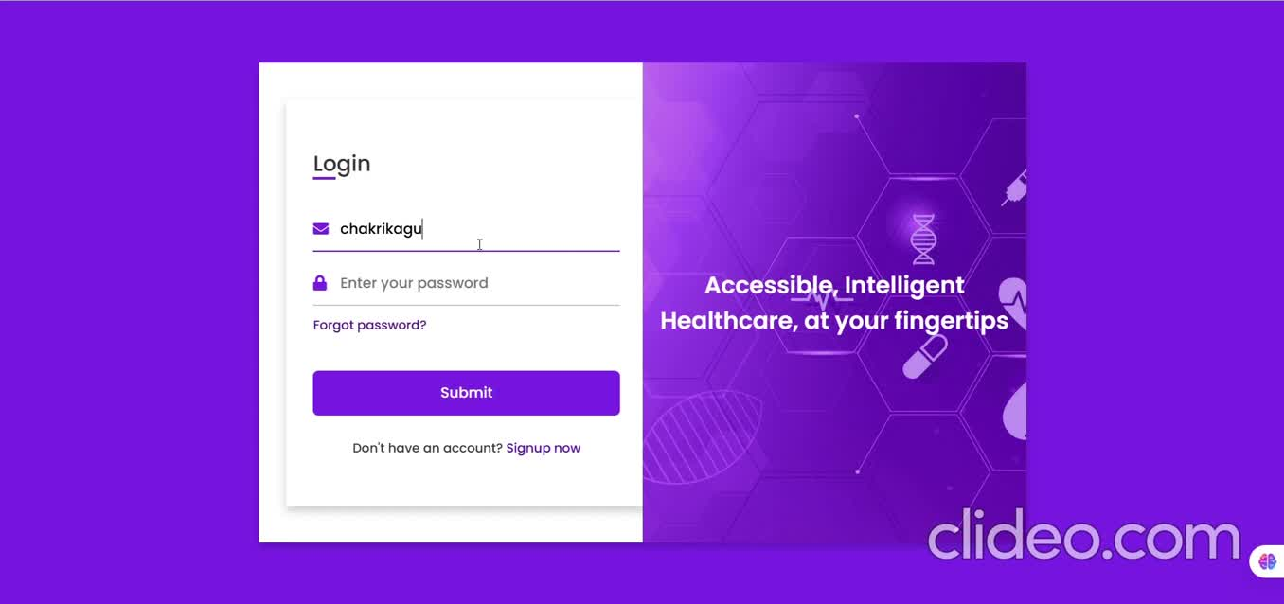
Demo Video

Slide 7
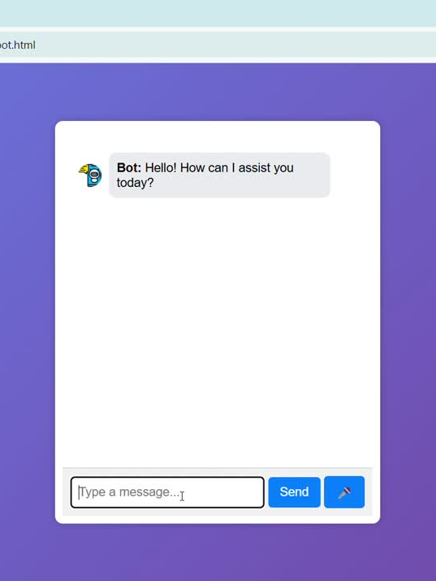
WOW Factor
50% faster appointment booking & allocation
30% more efficient doctor utilization
Significant reduction in patient waiting times & missed appointments
Better healthcare experience for both patients & doctors

Slide 8


